Slide 1
Pollution and Our Neighborhood
Sarah Dedmon and Amanda Robison
First and Third Grade
Barclay Elementary/ Middle

Slide 2
Why?
Children need to be aware of their surroundings and challenged with how to take care of them.
Students also need to understand that their actions have consequences, both positive and negative.
Students also should analyze why people, including themselves, litter or pollute the environment and discuss and share how to change their behaviors.

Slide 3
Content Standards
First Grade
Topic
B. Environmental Issues
Indicator
1. Recognize that caring about the environment is an important human activity.
Objectives
Recognize and describe that individual and group actions, such as recycling, help the environment.
Recognize and describe that individual and group actions, such as littering, harm the environment.
Give reasons why people should take care of their environments.
Third Grade
MARYLAND SCIENCE CONTENT STANDARDS
2.0 Physics – Students will use scientific skills and processes to explain the chemical and physical interactions (i.e., natural forces and cycles, transfer of energy) of the environment, Earth, and the universe that occur over time.
BCPSS SCIENCE SKILLS AND PROCESS OBJECTIVES
3.1.B.1.a. Develop explanations using knowledge possessed and evidence from observations, reliable print resources, and investigations.
3.1.B.1.b. Offer reasons for their findings and consider reasons suggested by others.
3.1.A.1. Constructing Knowledge - Gather and question information from many different forms of scientific investigations which include reviewing appropriate print resources, observing what things are like or what is happening somewhere, collecting specimens for analysis, and doing experiments.
3.4.A.1.b Organize and display data to make tables using a variety of categories and sets of data
3.4.B.1.a Interpret data contained in tables using a variety of categories and intervals

Slide 4

Brain Target 1: Emotional Connection
Unit Introduction: Buddy
reading of The Lorax and class
discussion
Talking chips are provided during group work to ensure the participation of every student
Numerous tradebooks available
Students will look at a map of the surrounding neighborhood and discuss where they live in relation to each other
Students will be shown pictures of polluted environment and record their observations and feelings
Begin lessons with sharing a poem or story about the environment.
Students will take an environmental walk and discuss how human activity influences pollution. Students will discuss how pollution impacts their surrounding environment, animals and natural resources.
Students will create their own poem about protecting our environment and making their community a clean and healthy place to live.
Students will grow plants to be planted in our playground garden and discuss what kind of environment they need to grow.
The teacher will encourage students to share ideas through daily journal writing.

Slide 5
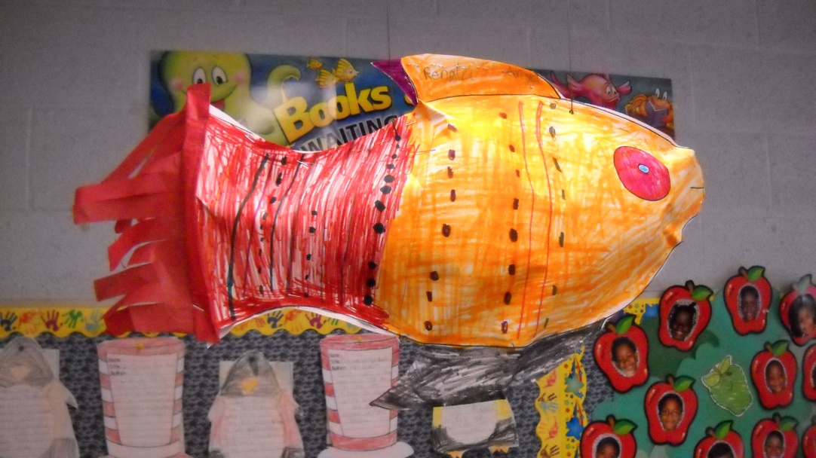
Brain Target 2: Physical Environment
Plants brought into the classroom
Students will create a 3D model of a tree on the bulletin board to display their current work on
Play soft music-woodland sounds
Frequent breaks and movement built into each lesson “BRAIN GYMS”
Fish mobiles created out of recycled materials hanging from the lights
Student created work such as poems, stories and artwork will be posted throughout the room.
Have students create a mural for clean environment and polluted environment. This will be hanging
on the large back bulletin board.
Post types of pollution chart in the
classroom and any other charts we create.
Have pictures of the ocean, land and
sky in the classroom. These pictures
represent the parts of our environment
affected by pollution. Students can post
thoughts or ides.

Slide 6
Brain Target 3: Big Picture
Learning Design-1st grade
Pollution in the Environment
Land
Causes
Effects
Air
Causes
Water
Effects
Causes
Effects
What can we do?
What can we do?
What can we do?

Slide 7
Brain Target 3: Big Picture Learning Design-3rd grade

Slide 8

Brain target 3 Cntd.: Learning Goals
First Grade
Identify and discuss parts of our environment
Identify and discuss various types of pollution that we observe and what the causes are
Analyze the harmful effects of pollution and create a plan to stop them
Explore the scarcity of resources due to overuse and pollution
Third Grade
Students will be able to:
  Identify and understand the influences of pollution on people in the past and today. Also demonstrate an understanding of the influences of pollution on the environment, animals, and natural resources.
  Students will be able to identify types and causes of pollution.
  Students will be able to solve real life problems related to pollution and recycling.
  Students will be able to distinguish different forms of pollution and discuss the causes.

Slide 9
Brain Target 3: Assessing Prior Knowledge
Class will create a KWL chart about pollution and the environment
Two pictures of the environment in The Lorax will be displayed to the class and students will discuss what caused the changes

Slide 10
Brain Target 4: Mastery and Procedural Knowledge-1st Grade
Songs about pollution
Students will write a new ending for The Lorax with their book buddies about what will happen if the boy and the Onceler planted the Truffula seed
On a neighborhood walk students will be “Pollution Detectives” and identify evidence of pollution using their eyes and flip cameras.
Rewatch the footage and make a list of the
types of pollution as well as causes and effects of
it using visible thinking routine, “I see, I think,
I wonder…”
Use the list to create a plan to address the
pollution
Implement the plan by creating signs for yards,
picking up trash, etc
On a walk, collect litter and sort upon return to
school. Class will complete a “litter tally” and discuss
the results and share with other classes
Repeated rehearsals of how to observe and record

Slide 11
Brain Target 4 : Mastery/ Procedural Knowledge-3rd Grade
Students will explore their environment by being an environmental detective for the day and taking notes about their surrounding. They will share their findings with the class and discuss reasonable solutions to clean and protect their environment.
Students will create a brochure for protecting oceans, air and land. In the brochure students will show pictures and write why it is important to protect our natural resources.
Students will create a poster to promote reduce, reuse and recycle.
Students will create a classroom mural showing a clean environment vs. polluted environment.
Students will read The Lorax and create their own version or ending to the story.

Slide 12

Brain Target 5: Application of Skills in a Real Word Setting
To demonstrate the effects of litter, class will use a terrarium to bury an apple, a glass bottle, a can, and a plastic bottle for one week. The class will dig them up and see that the manmade materials do not decompose in the earth.
After street cleanup, revisit the next day and have students analyze the differences. Discuss ways they can make a bigger change.
Have students model and explain the effects of littering for Pre-K or K classes.
Write a persuasive letter to their neighborhood newsletter or city councilmen discussing their observations and what needs to be changed to create a cleaner environment
Neighborhood Walks and Cleanup
Third Grade:
Recyclable sort and graph.
Create a chart for types of pollution and why pollution has occurred and increased.
Have students write about how pololution will affect our future if we do not take care of our environment.
Have students hold a cleanup trash day at school.
Students can make a skit about preserving and protecting the environment to present to parents and the school.

Slide 13
Brain Target 6: Evaluating Learning
First Grade
Smiley face rubric used on journals and responses
Students will work in pairs to create dioramas showing the effects of pollution on a clean environment
Informal observation of participation in activities such as brainstorms, read alouds, discussions, etc
Teacher Rubric and Student Rubric for persuasive letter
Peer Assessment of dioramas: Visit each diorama and identify the type of pollution and the effect the students showed using a graphic organizer
Third Grade
Create a portfolio of student work that will include all art activities and writings that students complete.
Teacher will keep anecdotal records for all observed activities.
Students will journal daily.
Endangered species report, shared with first graders.
End of unit test.
Pollution
Effect

